Slide 1
MODAL VERB CAN
Presentado por:
Pablo Ramírez
Carlos García
Jonnathan Morales

Slide 2



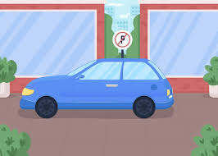
MODAL VERB CAN
We use Can or Can´t to talk about ability, possibility or permission.
Ability:
She can swim
Possibility:
It can rain tomorrow
Permission:
You can´t park here!!

Slide 3
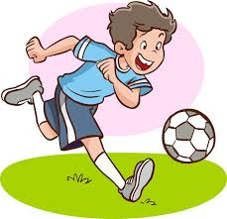
MODAL VERB CAN
Positive modal verb can:
Structure
Pronoun + can + verb + complement
I can play soccer

Slide 4
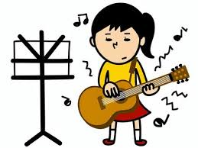
MODAL VERB CAN
Negative modal verb CAN :
Structure
Pronoun + can´t (can not) + verb + complement
I can´t play the guitar

Slide 5

MODAL VERB CAN
Questions with CAN or Can´t :
Structure
Can (OR CAN’T)+ pronoun + verb + complement + ?
CAN i go to the toilet?
Can‘t i go to the toilet?

Slide 6
Thanks!!

